Slide 1
Team#4
Project Title:
Furniture and room designing tool with AR and AI

Slide 2
Team members
1
Mohammad Saed Alsaid - 1800838
5
Oğuzhan Kalkuz - 1729304
2
Yousef Elbayoumi - 1722326
6
Bora doruk bilgin - 1729464
3
Hikmet Cagatay Yilmaz - 1728860
7
Muhammet tolga yildirim - 1730140
4
Sercan Emre Seviniş - 1728942

Slide 3

Problem definition:
Changing the design or the colors of the furniture has always been an issue for many people, and they are worried about putting their money on some new designs because they aren't sure about the result, and some others don't have money issues, but they think long and hard before making any decorating decisions. On the other hand, they would really prefer to see their room Furnished without actually buying or changing the room, and without spending hours in imagining the outcome.
Scope:
The app is expected to be used by any person who needs to imagine the design for the specific room. The app will allow the users to scan the specific place with their dimensions. And the system will calculate the distance to prepare the user to implement their assumption of his/her design. They will be able to have a highly flexible way to use it everywhere. The system will prepare the necessary details for selecting items. By these things, the target audience will solve their problems.

Slide 4

Brief solution :
The application will solve many of the problems related to home furniture using AR and AI (Augmented Reality and Artificial intelligence). With the help of the application users will not be confused about home furnishing anymore, users will easily place 3d models of several companies' furniture such as IKEA, Hepsiburada, Sahibinden, Trendyol, N11, etc. in his/her place. The app has features such as scan, browse, select and place the objects, which makes deciding a new furniture easier than ever. Moreover, the application’s features are not limited to new furniture only, but also the application is able to modify the style of the current room such as the color of the walls, for example, the app will scan the user's room with colors and models to easily change the visual of the room. And for the final group of people, for those who want to change the appearance of their house or garden but don't want to regret later, our app is capable of creating new additions in the house such as new walls and windows, even being able to modify outside the house, for example in the garden.

Slide 5

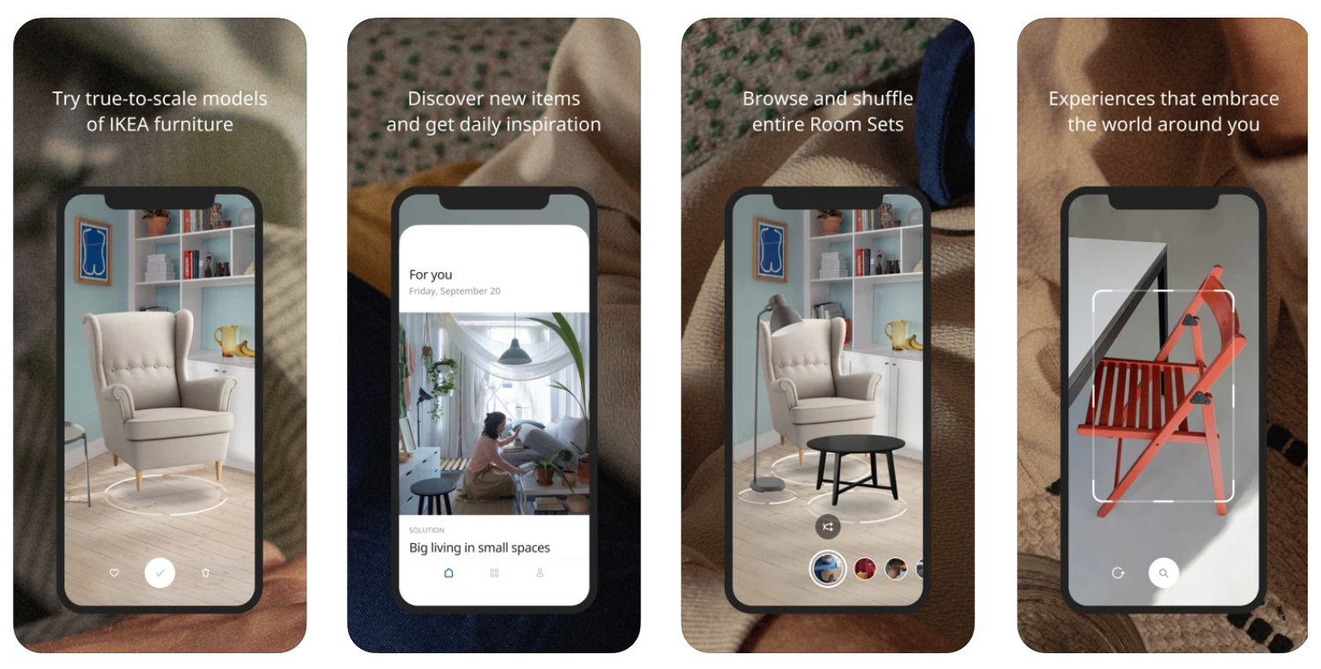
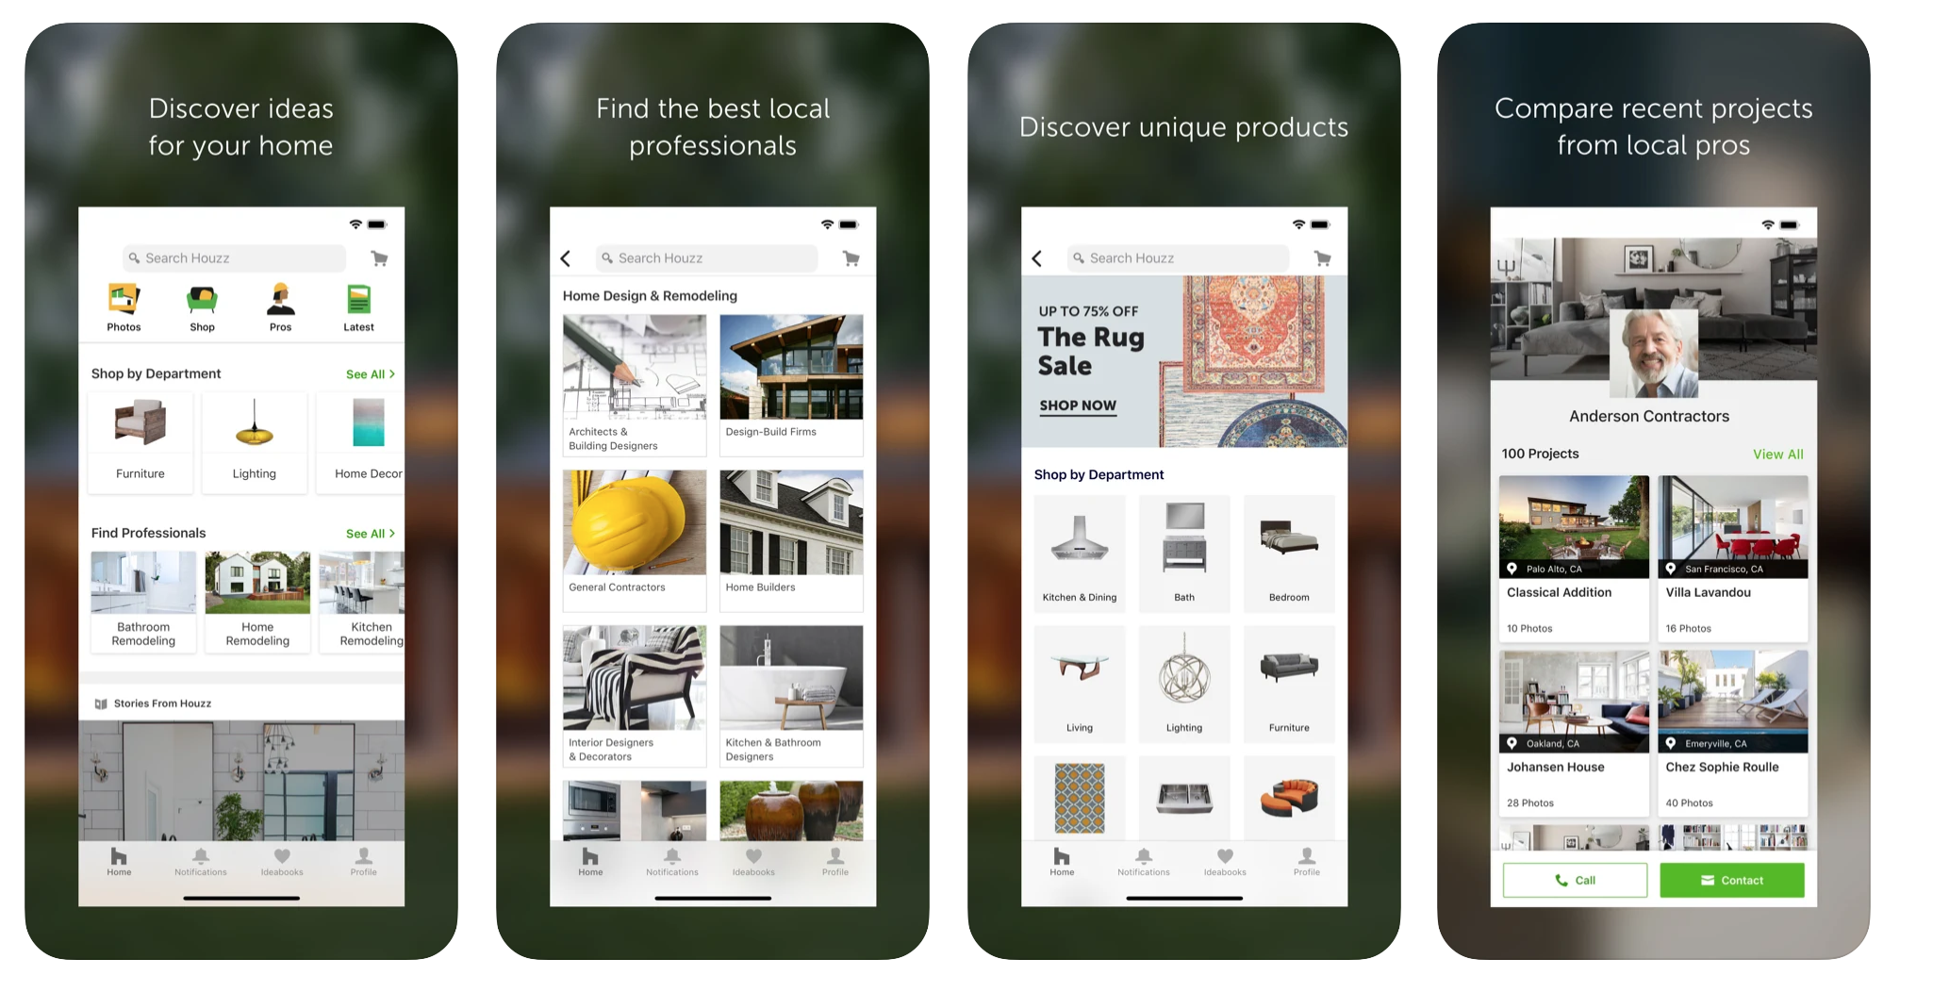
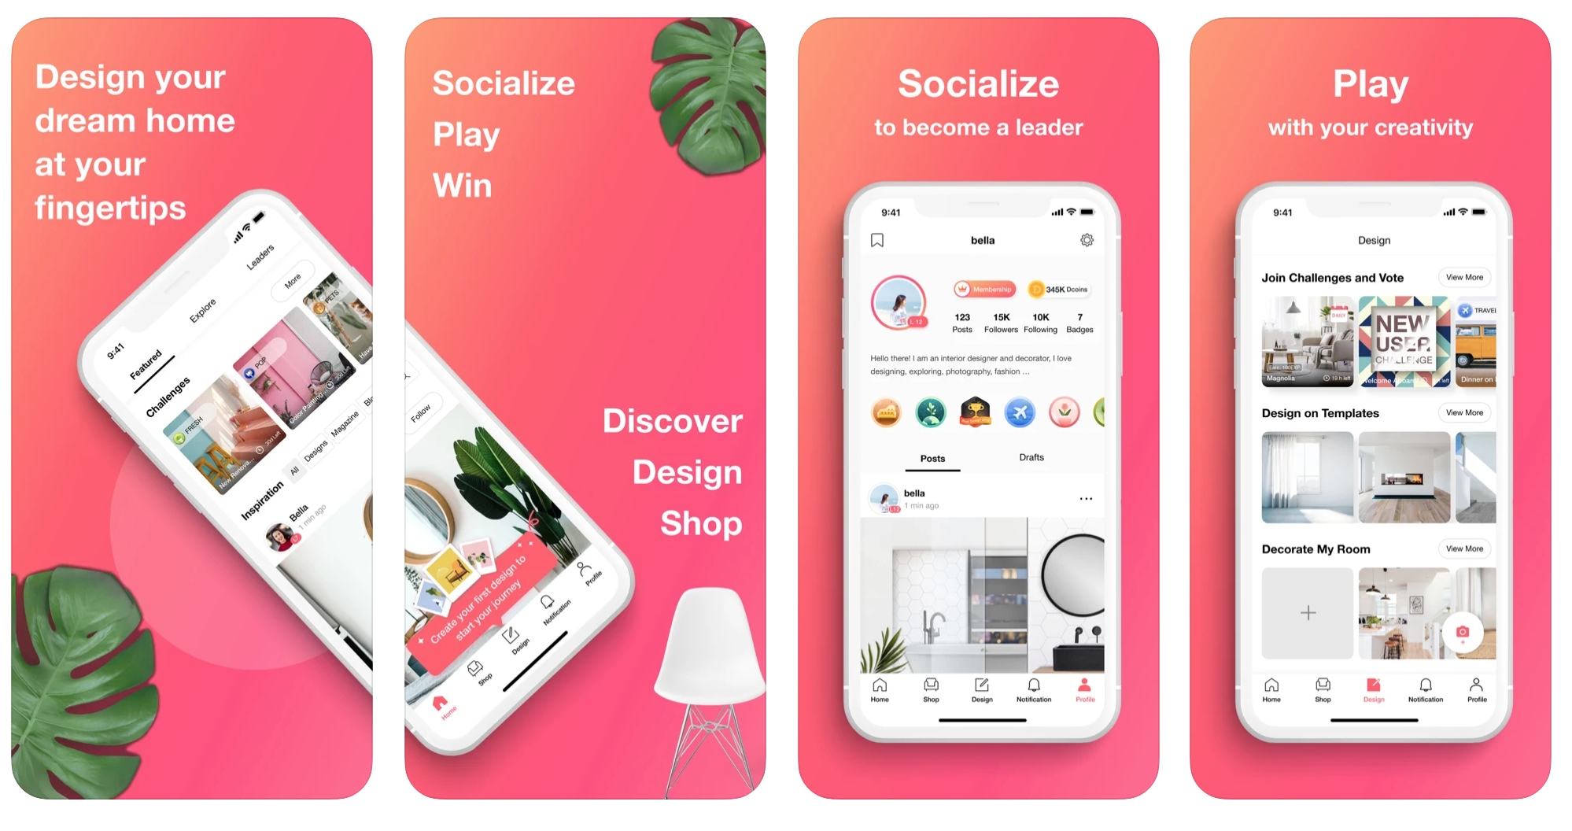
Similar App:
1- IKEA Place:
One of the huge companies in the furniture field. Which gives their customers an opportunity to try any furniture element as a virtual place in his/her user’s house. By opening the apps and choosing the available piece in the store to convert it in the virtual placement with taking the distance as if it is in real life accurately. The app launched in 2017, available only in IOS and also, the platform is built on ARCore.
2- HOUZZ
One of the best applications related to design, remodeling and decorating. Which took the AR technology and tried to invent an idea by linking it with stores that have more than 10 million products and sharing options to friends. This platform synchronizes with these products by taking the measurements and visualizing them as 3D models by AR. This application gained a lot of downloads by adding a feature of adding objective and move. The app launched in 2017, available in IOS and android.
3- DecorMatters
In contrast to IKEA Place, the DecorMatters provide a good visualization of the interior design. Using the shopping application and linking it to apps like amazon, wayfair, etc of applications. The newest feature is that the AR ruler helps to measure the size of rooms to compare it with the other items. Provide the users a good understanding which item should be used. The app launched in 2017, available only in IOS.

Slide 6





objectives:
AR Scanning for 3D perspective matching.
AI for declaring the colors of objects and suggesting colors to claim best harmony depending on a color palette.
Model database for ex. google poly to use in the room preview. It will also work outside, for example in garden design.
Not only addition from the imported models; also with AI, the program is already generating decoration models (potential new furniture), users can transform these objects also as they wish.
The app can also add new details to the home such as new windows, doors, walls, etc.

Slide 7





Requirements
Data requirements
Environmental requirements
- Payment system - data must be secure.
- Furniture’s data - data must be available 24/7.
- Furniture’s data - data must be updated (taken from the original website of the furniture, e.g. IKEA, Hepsiburada).
- User’s data - data must be secure.
- User’s data - if data is new, the system must ensure that it meets the app conditions (e.g. password must contain one capital letter).
- Physical requirements - The app must be usable in a wide range of lighting conditions - bright glare, evening.
- Physical requirements - The app must be usable in crowded places with people / objects.
- Physical requirements - The app must be usable outside the home (e.g. the garden).
- Social environment - The app will help the user to contact the company he chose from.
- Social environment - The user can read the comments provided by other users and discuss with them about it.
- Organizational requirements - The app will provide technical assistance to users.
- Organizational requirements - The developers will keep the app updated with newest furniture and prices with the help of the partners (other companies e. g. IKEA, Hepsiburada).
- Organizational requirements - The app will provide a sharing feature so users are able to share the last view they got with other friends.
Eliciting requirements
Questionnaire :
- How did you learn about the HomePlay app?
- Did you face difficulties using it for the first time?
- Do you think the HomePlay app is safe?
- Why do you use the HomePlay app?
- Was the app able to help you?
- Did you try other AR apps that work with the same concept?
- Do you think the HomePlay app is better than other apps?
- Is there something the other apps have and HomePlay doesn’t?
- Did you evaluate the app in AppStore / GooglePlay?
- Would you recommend the app for your friends?
- Do you have any further comments or recommendations?

Slide 8

Stakeholders (internal stakeholders, external stakeholders), Communication:
Stakeholders
The technology of object detection and recognition is already being tested out in many different industries for vastly different purposes. For example, home furniture, which is our topic idea, many companies such as IKEA have an AR application for a better marketing of its furniture, which allows the users to check the objects in their homes and be less confused about how it will look. Also for video surveillance, object detection techniques naturally lend themselves to automating video surveillance systems because they can effectively recognize and track many instances of a particular object in a scene. Moreover, object detection can also be used in crowd counting. Object detection can assist businesses and communities better evaluate diverse types of traffic whether on foot, in vehicles, or otherwise in heavily crowded areas like theme parks, malls, and city squares. And finally, self-driving cars, the success of autonomous vehicle systems depends on real-time car detection models. In order to navigate around the world safely and efficiently, these systems must be able to detect, find, and track items surrounding them.
Internal stakeholders
App ownership
Managers
Project team, the developers (employees)
Investors
External stakeholders
Communication
Customers, users of the app
Suppliers, the companies that provides the furniture
Competitors
Developers will meet on a daily basis and will share their ideas, progress, and problems they are facing. They will use methods such as minutes of meeting and standing discussions; these meetings can be called by anyone in the team but it needs to be approved by the project manager or the subgroup manager.
The subgroup managers will meet with the project manager once every week, they will discuss their tasks progress and all issues being solved. They will also discuss time and financial information of the upcoming tasks, agree on a certain schedule, and the financial budget for each group authorized by the project manager.
Finally, the project manager will keep the stakeholders informed about the latest updates, take their suggestions, and assure them that everything is going according to the plan. They will also discuss if any deadlines need to be extended or if any major problems arose.

Slide 9
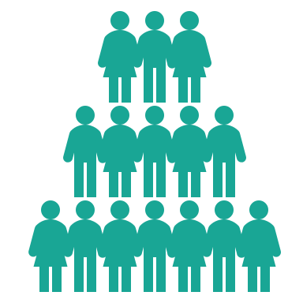
Project authority:
The project will be authorized by the project sponsor. The project manager (PM) will handle the project. Moreover, the scope and requirement are the project manager’s responsibility to prepare.In addition the PM will arrange with the implementation department to appoint the needed developers. The PM will then need to communicate with the Human Resources (HR) department to hire needed resources for the project. Furthermore, the PM will reach out to the marketing department to market the new application. Customer Relationship Department (CRD) will provide the PM with the customers' feedback. The PM will ask the financial department to help fund the project. Last but not least, the PM will handover the project to the operations department to implement the necessary resources.

Slide 10

Literature reviews related to our idea for:
Technology aided interior design has three main components: hard decoration design, soft decoration design and visual design (Li, 2015)
Augmented reality can allow architects to identify and analyze the differences between as-planned and as-built versions of the buildings (Rankohi & Waugh, 2013)
Improvement in software and hardware of mobile phones result in better performance for AR by making it more context-aware and location aware (Rankohi & Waugh, 2013)
Users tend to have problems while imagining 3D simulation of an interior design by using 2D photos (Li, 2015)
As rendering and tracking systems improve, the simulation of the house will be more successful, resulting in a better user experience of enhanced reality in interior design, visual effects and colors (Zhang, Li & Liu, 2019)
If the AI powered home designing apps has ease of use, users' approach to the system is more likely to be positive (Wang & Chen, 2020)
Notes:
REFERENCES
- J. Hui, "Approach to the Interior Design Using Augmented Reality Technology," 2015 Sixth International Conference on Intelligent Systems Design and Engineering Applications (ISDEA), 2015, pp. 163-166, doi: 10.1109/ISDEA.2015.50.
- Rankohi, S., & Waugh, L. (2013). Review and analysis of augmented reality literature for construction industry. Visualization In Engineering, 1(1). doi: 10.1186/2213-7459-1-9
- J. Li, "Interior Design Method Based on Virtual Reality Technology," 2016 International Conference on Intelligent Transportation, Big Data & Smart City (ICITBS), 2016, pp. 229-232, doi: 10.1109/ICITBS.2016.125.
- Yanxing Zhang, Lei Li, Beibei Liu, The Discussion on Interior Design Mode Based on 3D Virtual Vision Technology, Journal of Advanced Computational Intelligence and Intelligent Informatics, 2019, Volume 23, Issue 3, Pages 390-395, Released May 20, 2019, Online ISSN 1883-8014, Print ISSN 1343-0130, https://doi.org/10.20965/jaciii.2019.p0390, https://www.jstage.jst.go.jp/article/jaciii/23/3/23_390/_article/-char/en, Abstract:
- Chen, Zixuan & Wang, Xiang. (2020). Application of AI technology in interior design. E3S Web of Conferences. 179. 02105. 10.1051/e3sconf/202017902105.

Slide 11

First persona:
Persona: | Application User (Employee) | Fictional name: | Marianne Terrence
Photo: |  | Job title / major responsibilities: | Airline baggage handler, Manchester Airport
Demographics: | 31 years old Married Mother of two children Has a masters degree in Public Relationships. | Goals and tasks: | She is focused, honest, loyal, and hard-working. One of her concerns is to keep the tasks organized to maintain productivity. Spends her work time: - Collect, sort and check luggage against flight lists. - Making sure that items go on to the right aircraft. - Transfer luggage from the check-in areas to the departure areas. - Move luggage to and from aircraft holds using trucks
Environment: | She is comfortable using a computer, especially Excel for organizing the customers and luggages information. She refers to herself as an intermediate Internet user. She uses email extensively. | Quote: | “I see new faces everyday, this is good and bad.”

Slide 12
Second Persona:
Persona: | Application User (Retired) | Fictional name: | Jamison Rupert
Photo: |  | Job title / major responsibilities: | International tennis player, LTA, England
Demographics: | 65 years old Married Father of 4 children Grandfather of 9 children Has the NIAAA and AFAA fitness certifications | Goals and tasks: | He is brave, humble, consistent, and optimistic. He loves sports, and used in the past to welcome anyone to challenge him in his favorite sport, tennis. Spends his day with: - Playing tennis with his children and grandchildren. - Playing golf with his retired friends. - Exercises for maintaining fitness. - Watching tennis tournaments.
Environment: | He doesn’t like computers much as it steals our precious time, instead he goes to gym daily for fitness training. He doesn’t like staying at home all day, therefore he plays golf with other retired friends and neighbors. | Quote: | “It’s easy to become the champion, but maintaining it is the real issue.”

Slide 13

First Scenario:
Marianne is an employee working at Manchester Airport as an airline baggage handler. Everyone in the airport praises her mastery and dedication to work, and she is really making a lot of effort and time at work and taking courses and training. She is 31 but has more experience than many older people. Marianne is a married woman with a happy family consisting of a husband and two children, and they live near the airport, which makes her commute to work comfortable every day. One morning her husband (James) told her that he had gotten a big promotion and wanted to buy a bigger house. She was not entirely happy that she was leaving her house because it was close to her work, but on the other side she was excited to go to the big house with many rooms and a big kitchen. After several days, the family moved, but they were confused about the furniture, as they did not want to bring anything, and it turned out to be ugly. Marianne told her problem to her friend (Sarah) at work. The friend pointed Marianne into the HomePlay application, and it turned out that it was indeed the appropriate solution. She was able to check furniture and colors. In addition, the application was very entertaining with its many features such as multiple types of furniture and objects, sounds, and modification to the house itself such as windows and doors, Marianne evaluated the application and shared it to her friends.

Slide 14
Second Scenario:
Jamison is a retired international tennis player for England. By nature, Jamison is a man who loves to play tennis and is always looking for challenges, but due to his age and slow movement, he retired and started playing tennis not as a professional player but as a hobby. Jamison has four children and nine grandchildren, with them he plays tennis and teaches them to play golf. Due to the emergence of the Corona virus and the ban laws, it became obliged to Jamison to stay at home, even though he does not like to sit between four walls. Jamison by nature does not like mobile devices or computers because they steal time in his opinion and make the person fat. Jamison loves doing exercises daily to keep his fitness. Jamison's best friend named George and he was also a tennis player and they both retired in the same year, George told Jamieson about HomePlay application to keep him entertained during the quarantine period. Jamison enjoyed the application a lot and was already taking most of his time as he expected, but he felt that time is not wasted but rather to improve the house. Jamison placed several objects in his home and opened a new door because he saw it looks so good in the app. Jamison evaluated the application and shared it to his retired and not retired friends.

Slide 15

Use case
1. The user opens the camera and points it to the targeted area.
2. The system displays possible furniture instances that may fill the areas correspondingly.
2.1 If there is no area to be filled, the system directly suggests color options to increase the harmony in the field.
2.2 If there is no area to be filled, the system allows user to change the placement in the area and suggest some possible variances.
3. The user imports the furnitures s/he likes to try from contracting companies’ furniture list.
4. The user types the furniture type for system to display the custom items that exist in the app.
5. The system displays custom furnitures existing under the relevant categories.
6. The user places the furniture into the space and arranges its coordinates.
7. The system proposes color variances and placement suggestions constantly during the usage of the app.
8. The user saves the updated area to reach it afterwards.
8.1 If the user forgets to save the area and point the camera to another place, system saves the former image of the room and displays it again when the user come to the former area until user exits the app.
8.2 If the user forgets to save the image, system displays and warning message before the user exits the app.
9. The system loads the saved furnitures and colors and integrate it to the field in the app again if smart phone’s camera points to the same place as saved image.

Slide 16
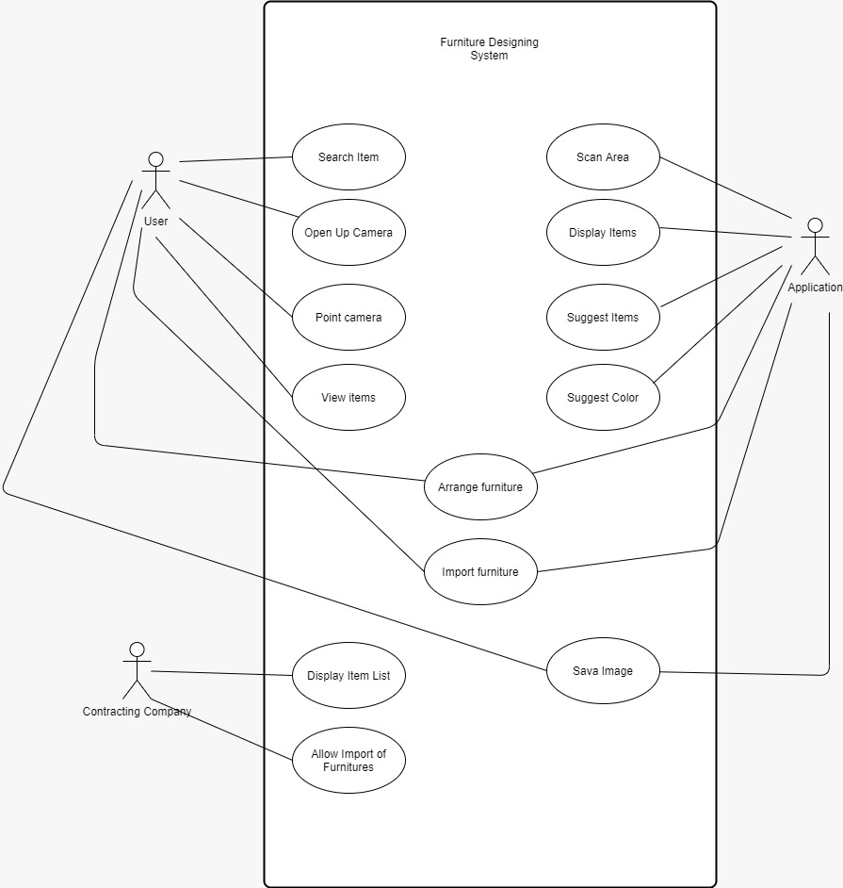
Use case
Essential Use Case:
Use Case Diagram
User Intention | System Responsibility
Point the smart mobile phone camera to the targeted area | Use AR scanning to scan the area and use AI to suggest furnitures to scanned places.
Select furniture to add to the room/garden and arrange its place | Allow user to change places of items according to physics laws.
Change color of items in the room/garden | Allow user to change colors and suggest matching colors with the help of AI
Save the current view for possible future use | Save the data into a database and load them when needed
Change the attributes of the items such as width, length, depth | Open a submenu for user to change the attributes Disallow changing the attributes in case of collapsing of items in terms of collapsing

Slide 17


User-Experience Criteria and Usability Criteria:
Usability goals:
Effective
- The app will be able to move more than 50.000 objects as a beginning.
- The app will provide real dimensions for the objects to provide the best understanding for the users.
Efficient
- Our AR ruler feature helps save much time by measuring the sizes and dimensions.
- The app is capable of placing new objects such as walls, doors, and windows in a short time.
Engaging
- The app recognizes the texturing of objects, and lighting of the room is considered.
- Users can view the new added 3D objects from any angle.
Error Tolerant
- The app ensures users are not exposed to the risk of making unnecessary and unsuitable purchases.
- The app has the feature of saving all changes automatically in case any error occurs.
Easy to Learn
- The app will scan the user's room with several colors and objects with the help of AR and AI.
- The app is designed to be easy to use for at least 80% of new users.
Usability experience goals:
Enjoyable
- The app has appropriate and effective sound effects and visuals.
Portable
- Easy to carry around.
Consistent
- The app has a predictable pattern that is easy to use and navigate.
Helpful
- Saves much time and effort.
Satisfying
- Users can achieve their goal.
Clear language
- The used language is simple, clear and precise.
Informative feedback
reliable and informative feedback are provided to users on time.

Slide 18

User profile and User needs
User profile
User needs
Several home designs
Several objects and furniture
Getting rid of uncertainty
Being able to make fast decisions
Employed people
Retired people
User isn't active but wants to have a good home design
Visual learners and prefer to see the design
Struggle with having multiple designs

Slide 19

Task Analysis:
Hierarchical task analysis(HTA) is used to explain descriptions of system in detail and usage of the app during the process of usage.
0. In order to integrate a furniture into a real area and see how it looks
Open the app from the phone.
Point the camera to the aimed area.
Access menu bar.
Choose a website/company to retrieve the furniture from.
Use the website of the company and select an item.
Click the insert button to insert the furniture into the app.
Find the intended item type.
Open the search screen from the menu.
Enter search criteria.
Select the targeted furniture.
Insert it into the real view by clicking add button under the furnitures.
Arrange the placement of the item/items.
Select the item to be replaced.
Drag the item to the targeted place in 3D coordinate system.
Enter coordinates or attributes of th furniture such as length, width, height, depth to arrange the furniture.
Change the color of the items arbitrarily.
Click on the furniture.
Use suggested colors from the submenu.
Open the color list.
Change the color codes arbitrarily.
8. Save the current view for later usage.
Plan 0: If specific furniture is going to be used, do 1-2-3-4-6-7-8. If not, do 1-2-3-5-6-7-8.
Plan 1: If suggested furnitures is adequate, do 1-2-5.c-5.d-6-7-8. If not, do 1-2-3-5-6-7-8.
Plan 2: do 1-2-7.a-7.b. If color is wanted to be changed arbitrarily and in detail, do 1-2-7.a-7.c-7.d.

Slide 20

Technology:
Since our project will use artificial intelligence and augmented reality, it should perform well. Therefore, it is the most efficient way to develop natively not hybrid because of performance and scalability problems. Both IOS and Android contain “Image Processing” frameworks in ready.
IOS: Swift
Android: Kotlin
Database: MongoDB
It's crucial to use a flexible and scalable database because of plenty of photos taken by users and machine learning through these photos. For this reason, noSQL-based MongoDB is preferred.
Server: AWS or Google Cloud Platform
Serving the application over the cloud can provide better performance and benefit the development team.
Environment: Mac, Windows(Not Mandatory)
In order to develop an IOS application, a device with macOS is needed. The Android application could be developed in both environments.
Tools: OpenCV, Figma, etc.
There should be many tools using thorough the development of the application, these are the worth to mention ones. OpenCV provides AI-supported image processing that we can use for our project for both augmented reality and machine learning. Thanks to Figma, easy-to-use interfaces can be designed, so there is better interaction.

Slide 21

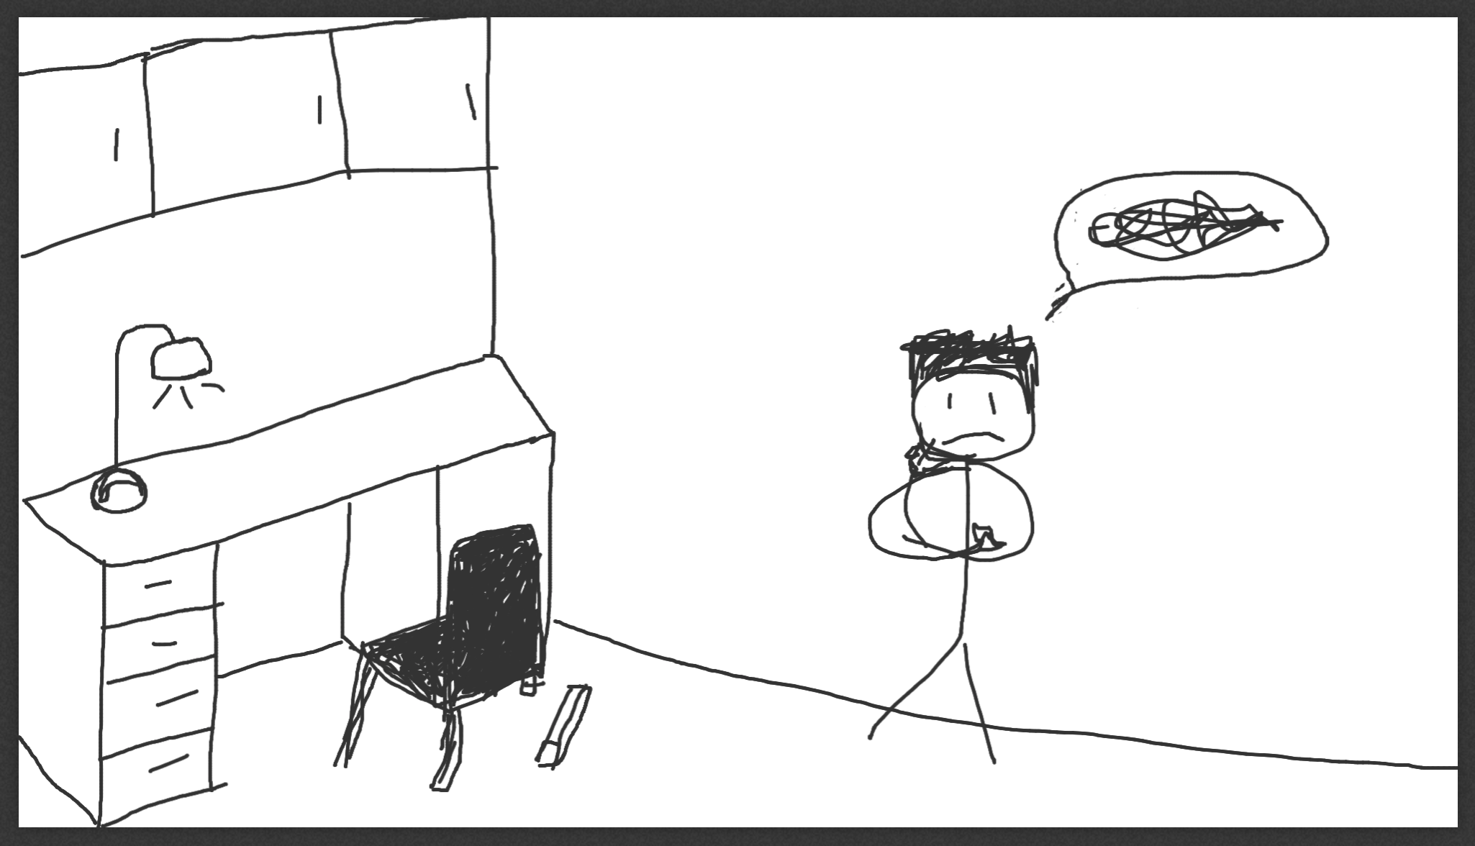
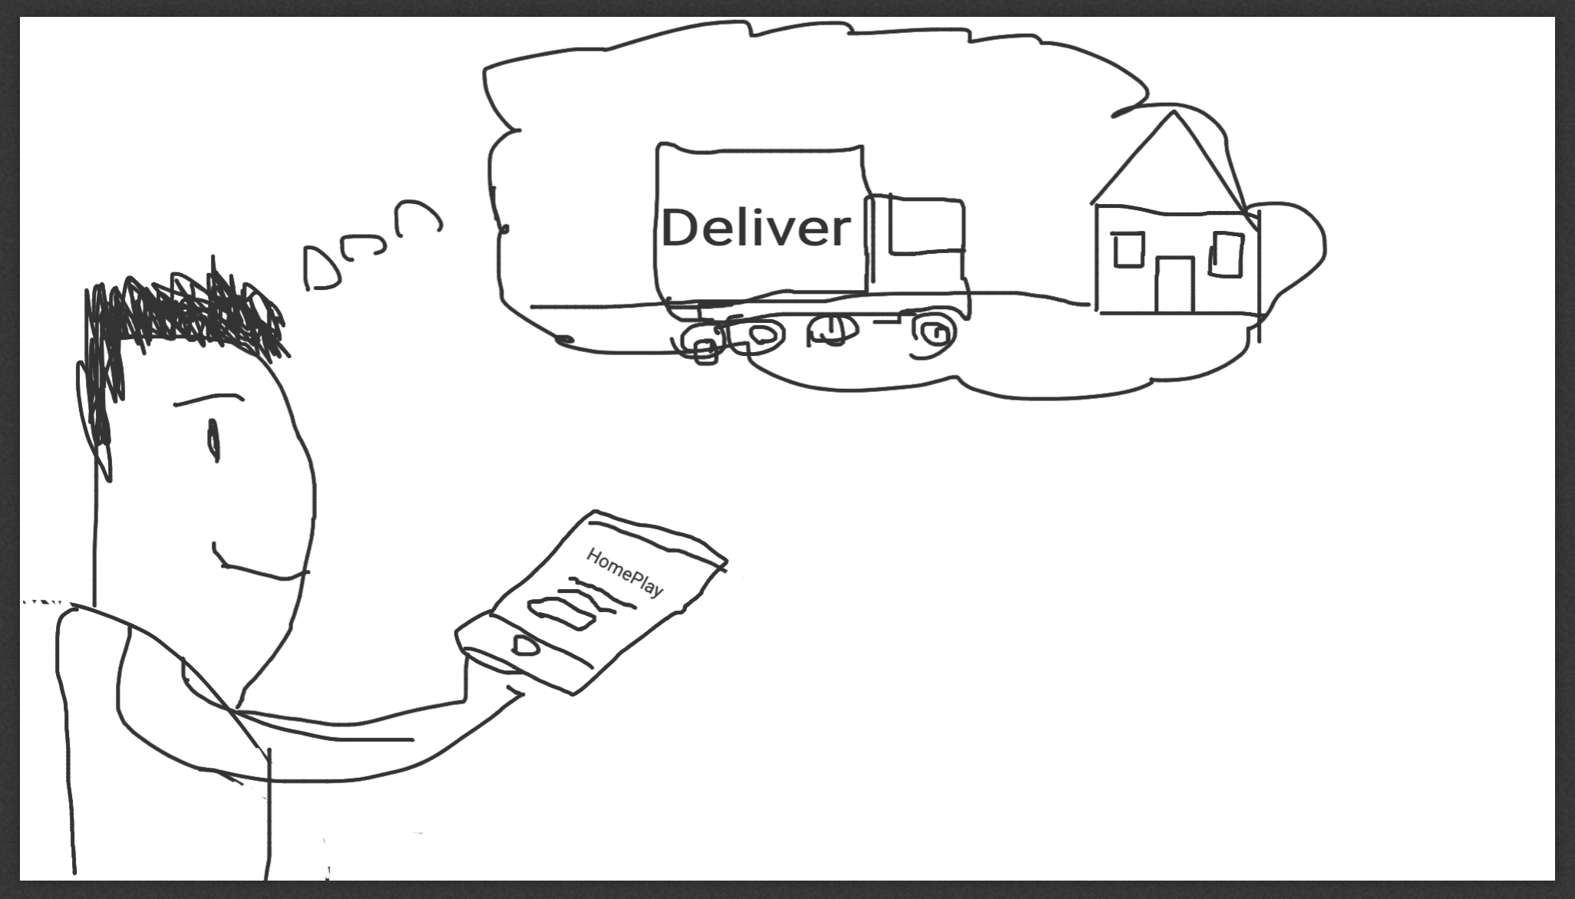
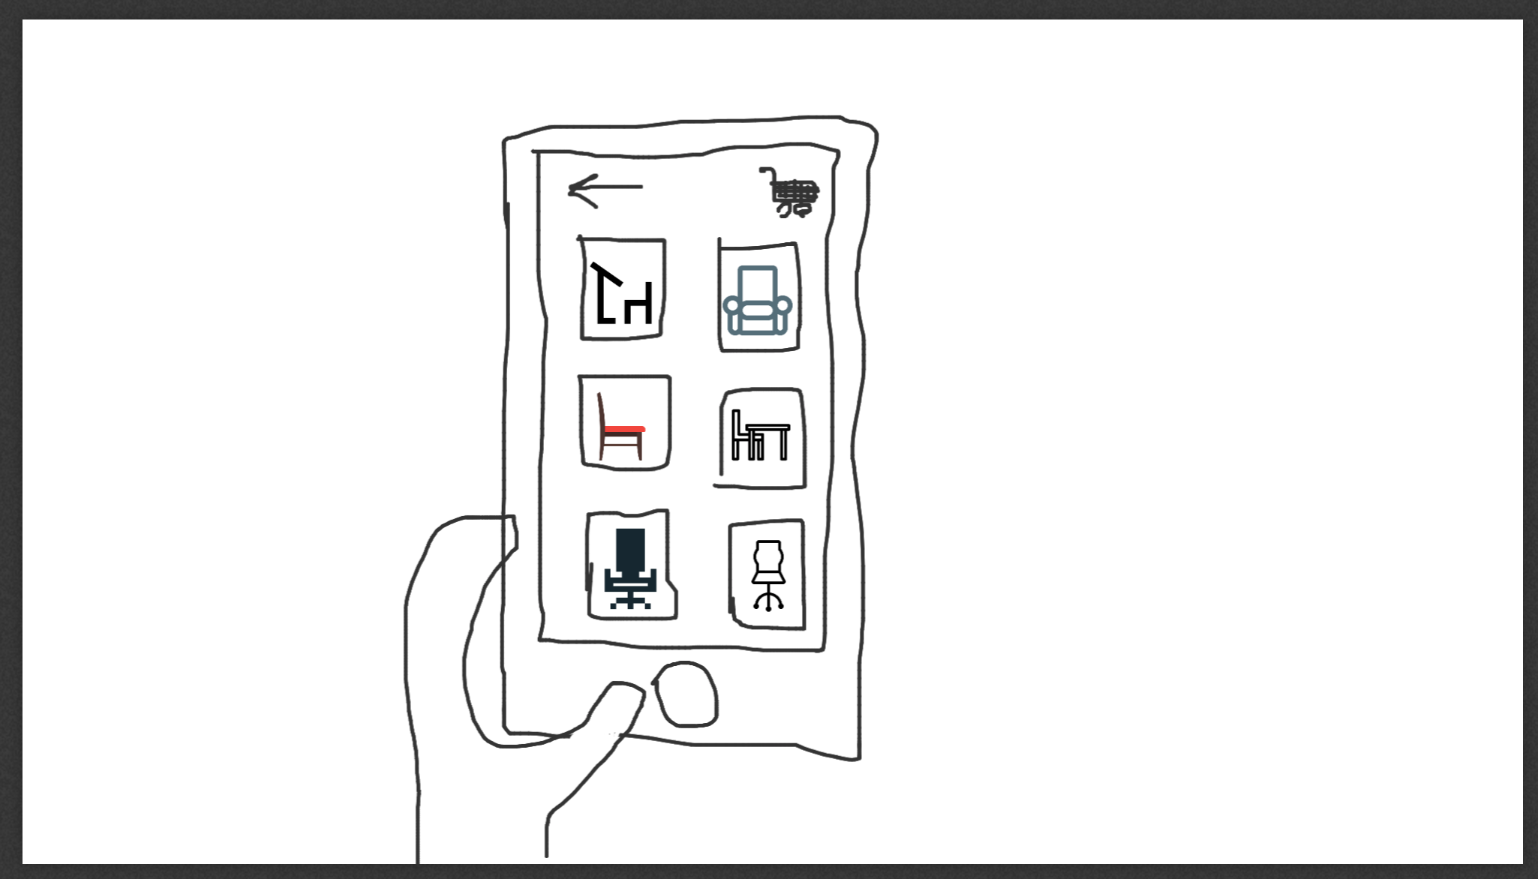
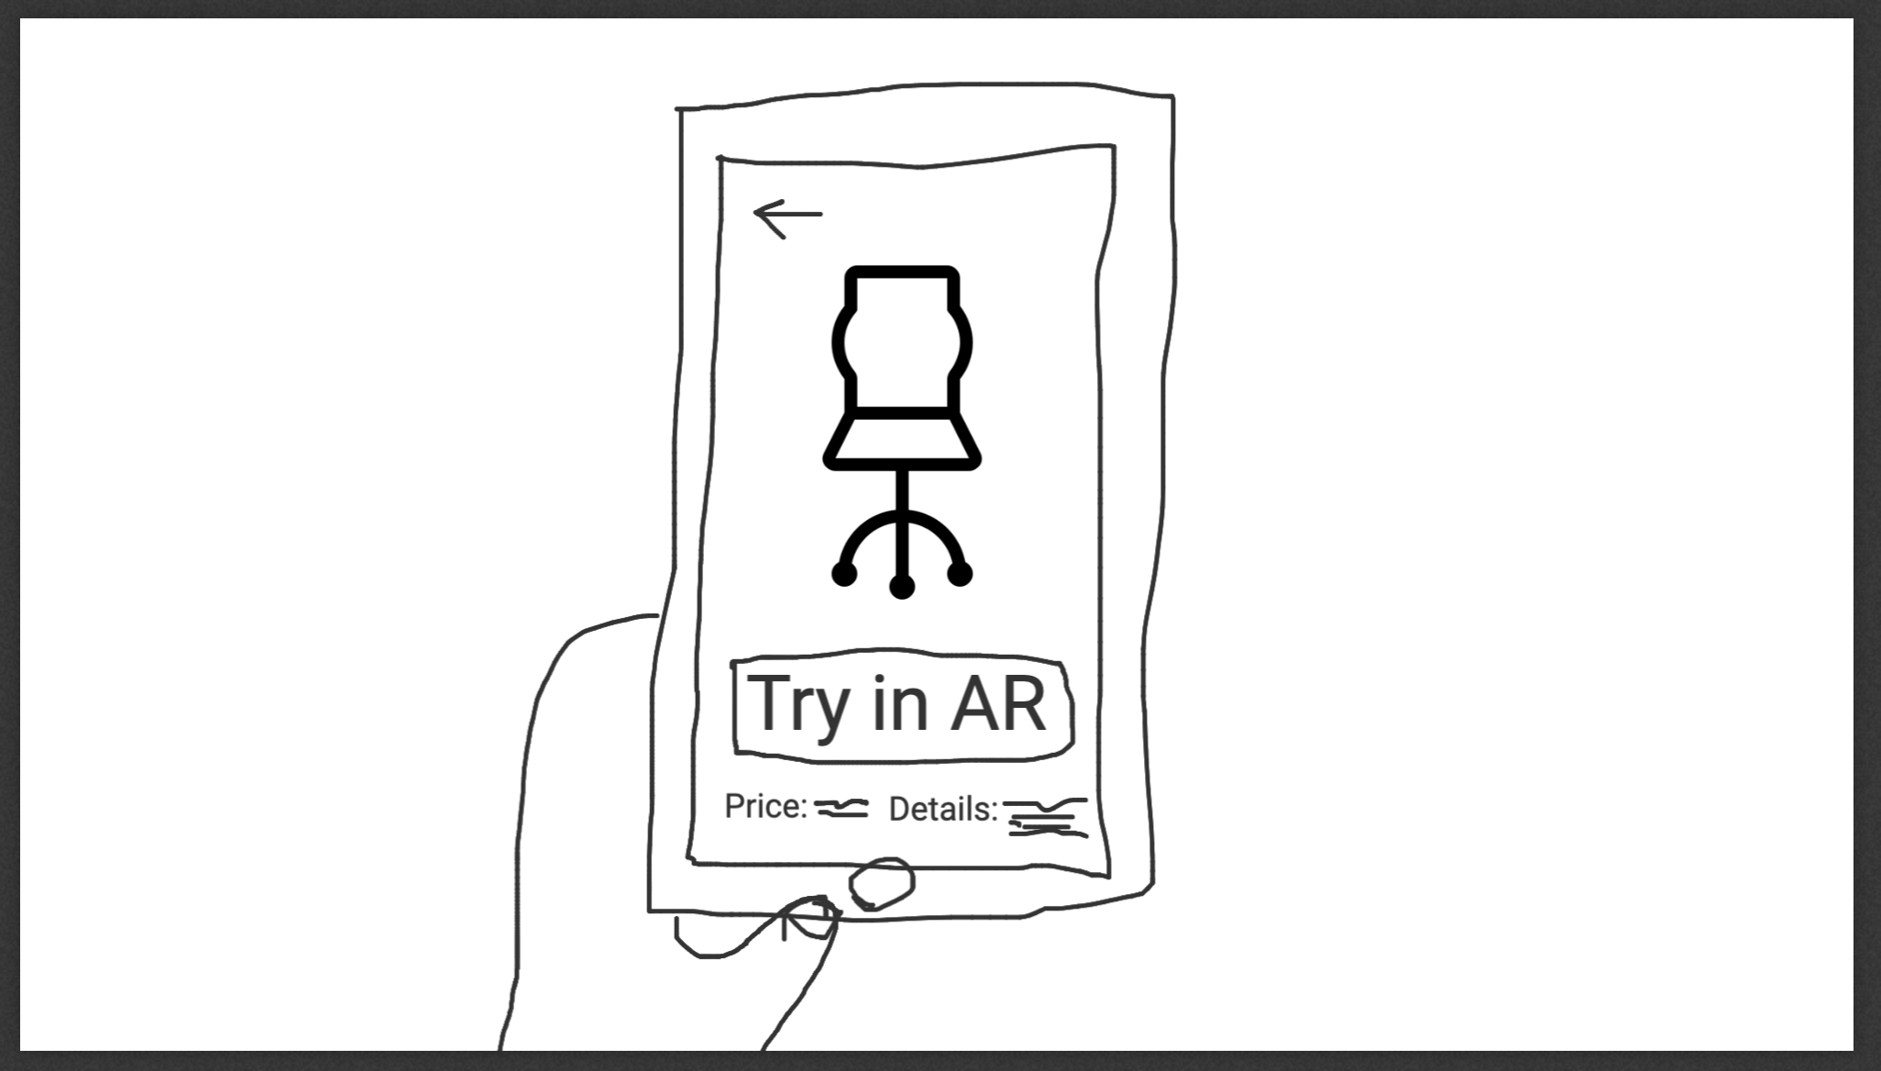
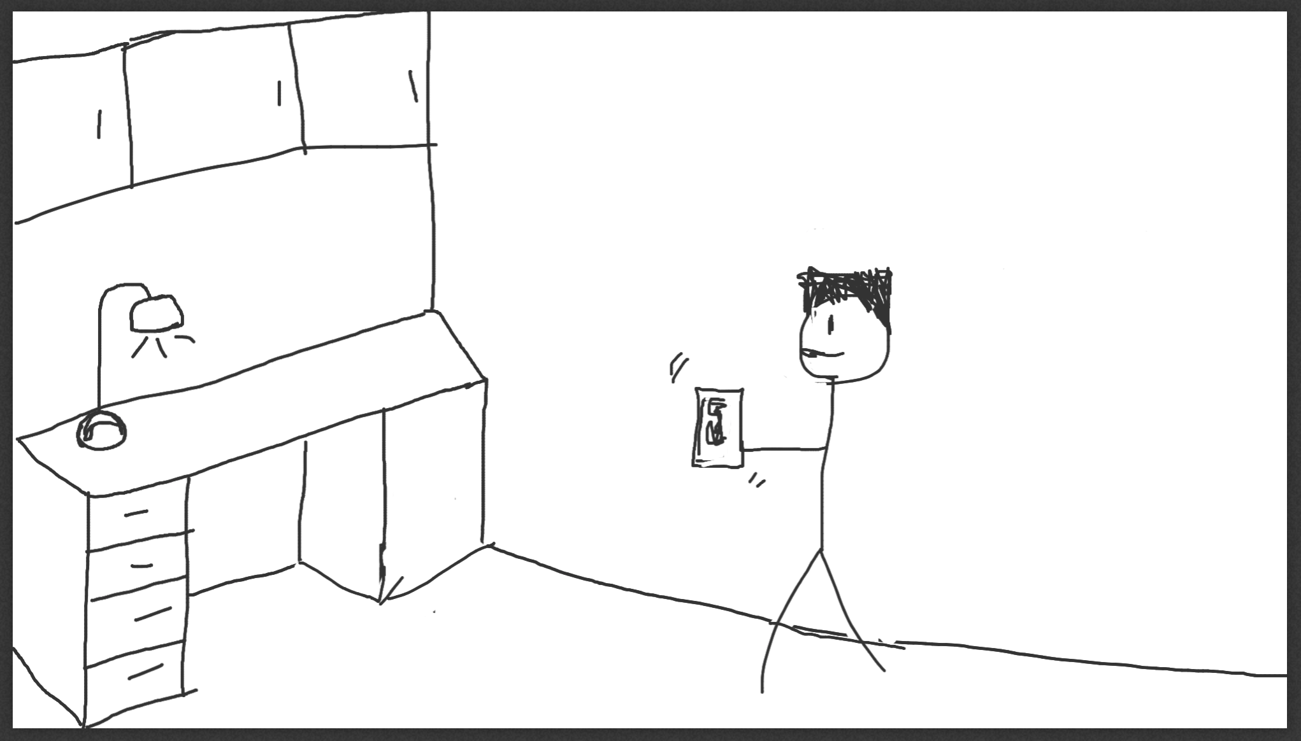
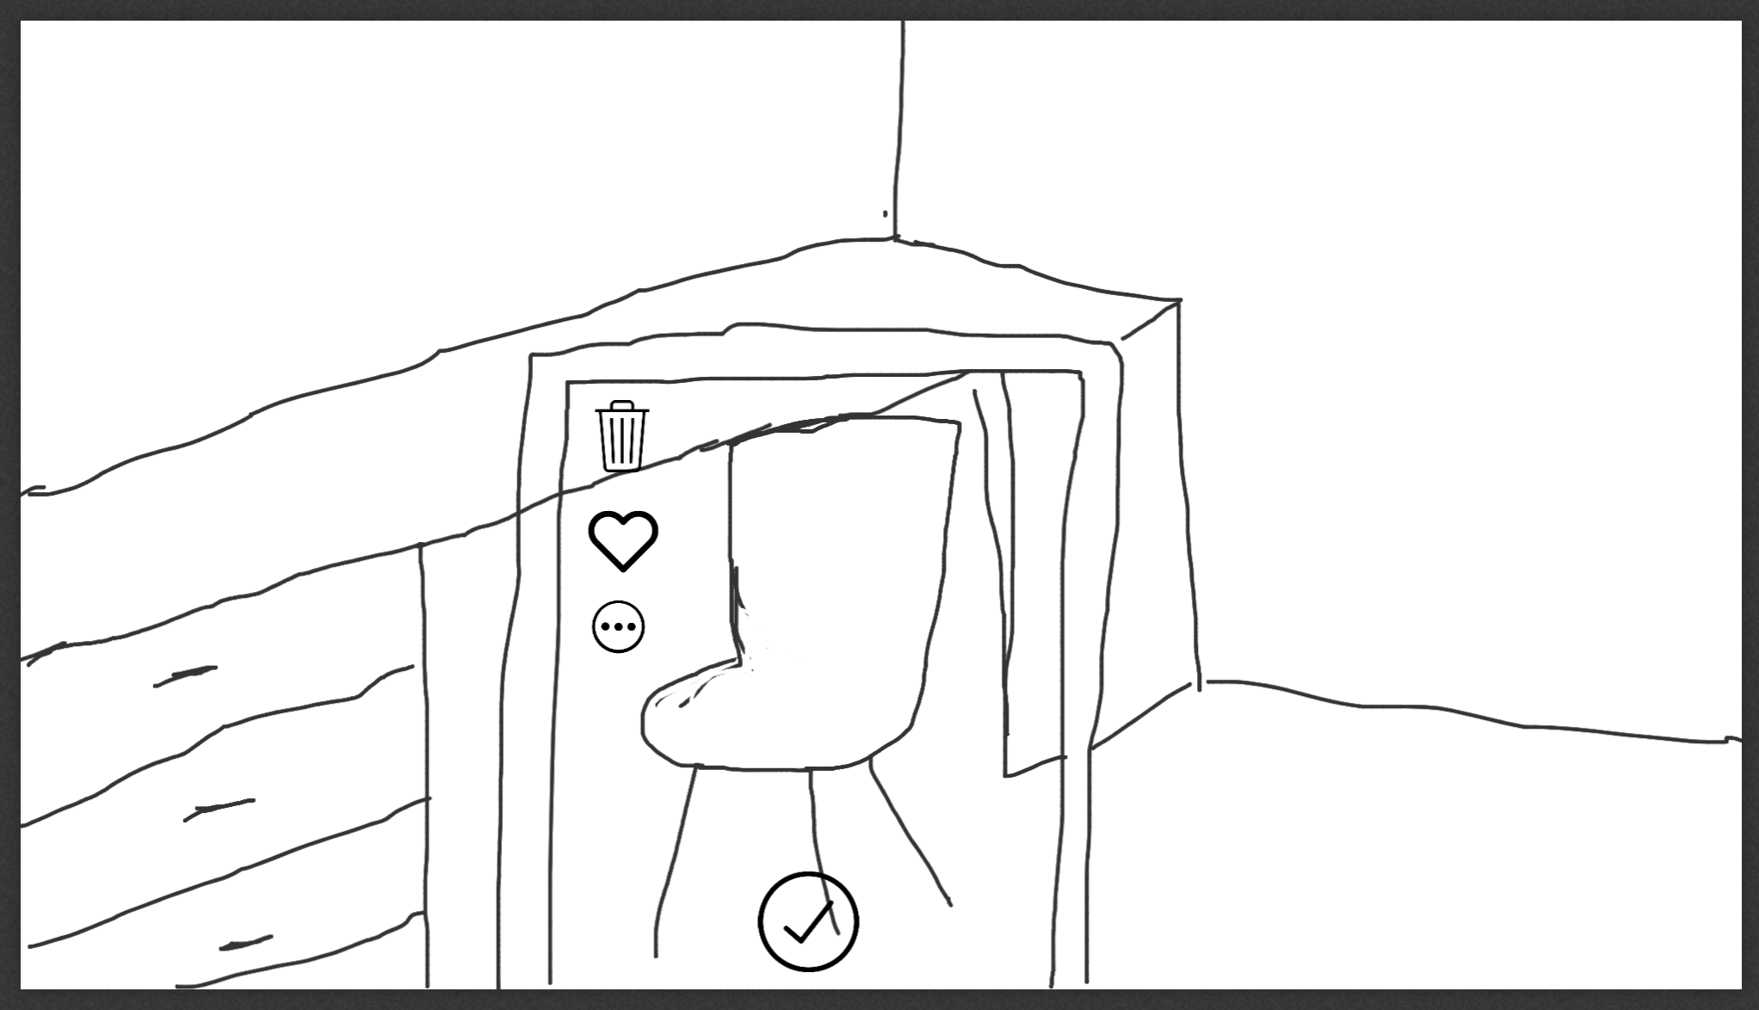
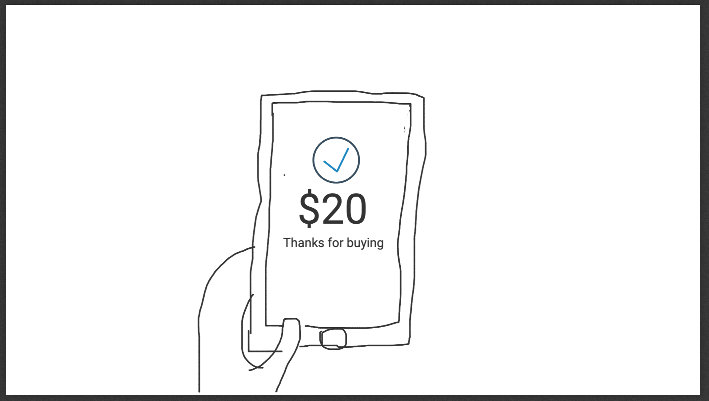
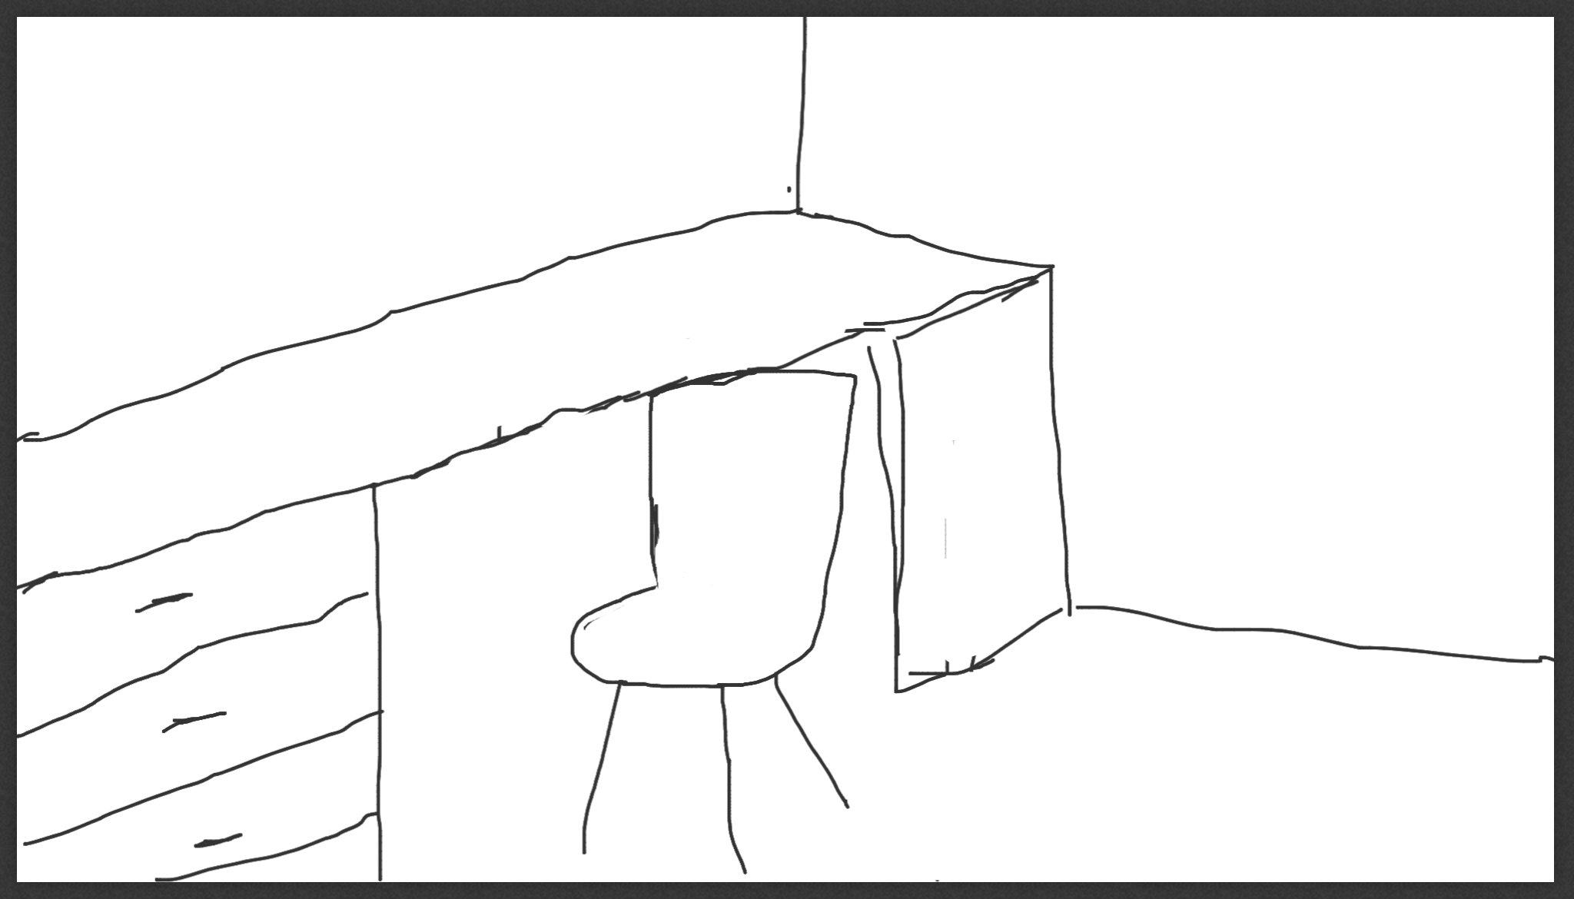
Storyboarding:
1
2
3
4
Jamison’s old chair is broken. He wants a new one
He find the HomePlay application that easy to choose instead of going many shop stores.
He search to many chairs could fit to what want.
He find some thing could fit to what want but not sure, so he try the option try in AR.
5
6
7
8
When he click it, open the camera, tries to place the chair in front the desk to see if it suitable.
It looks good to him, he looks to size and style. So, he found what he wants.
After that he buy it and put details of the address to come.
The chair come and the size and style as in the application.

Slide 22

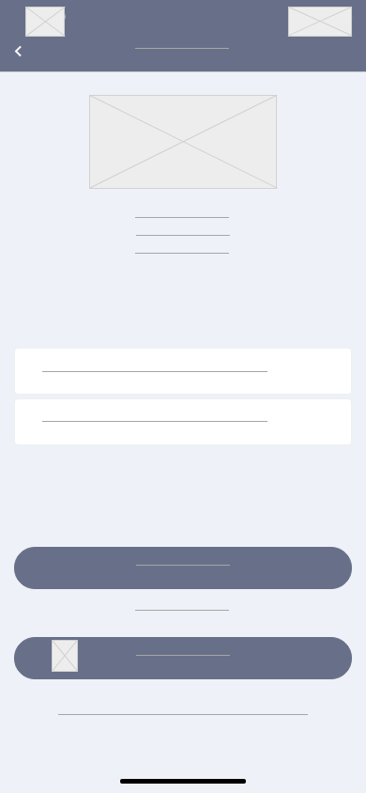
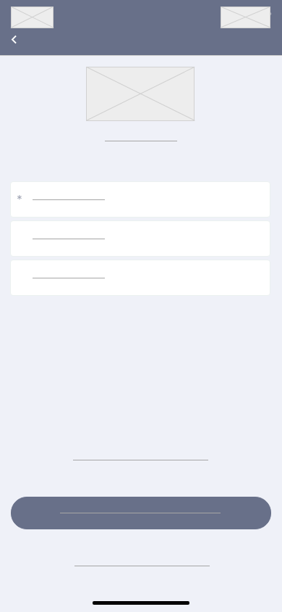
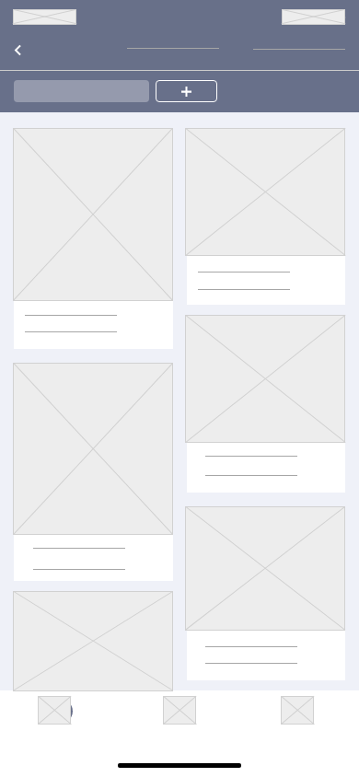
Low-fidelity:
Sign In page
Sign Up page
Search page

Slide 23
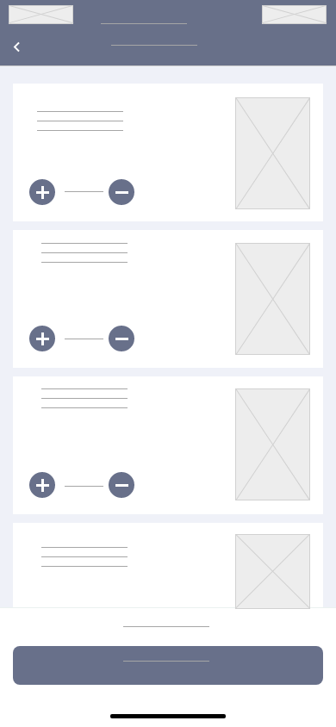
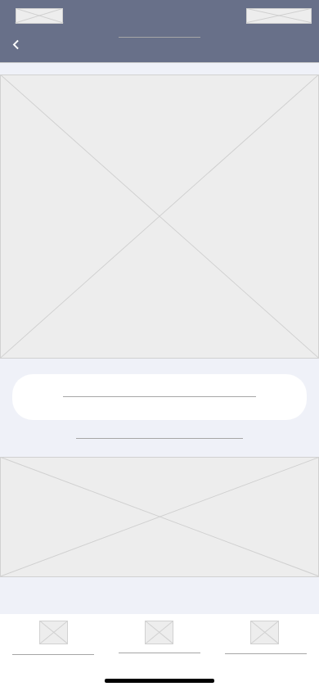

Low-fidelity:
Basket Page
product page
Camera AR Page

Slide 24

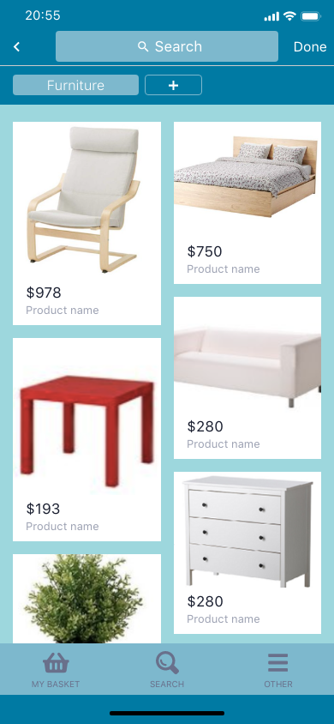
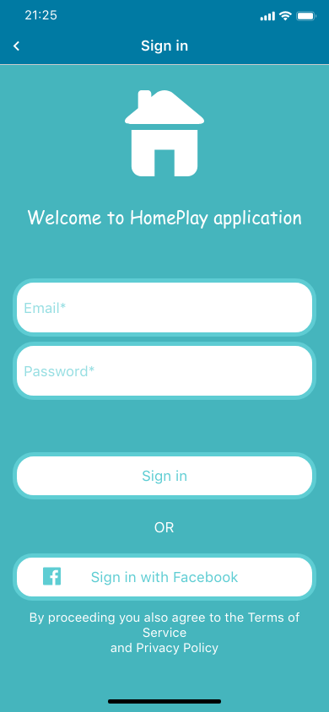
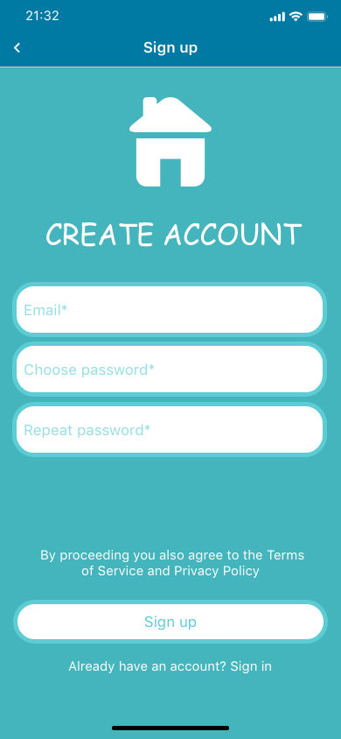
High-fidelity :
Search page
Sign In page
Sign Up page

Slide 25
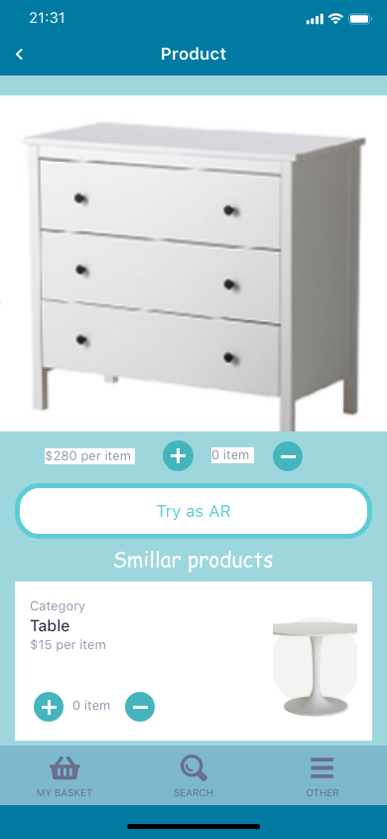
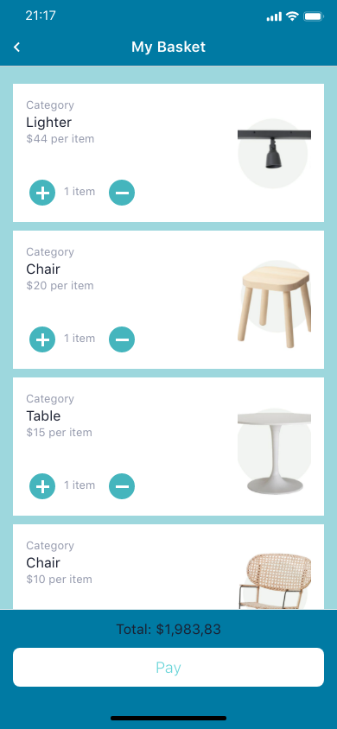
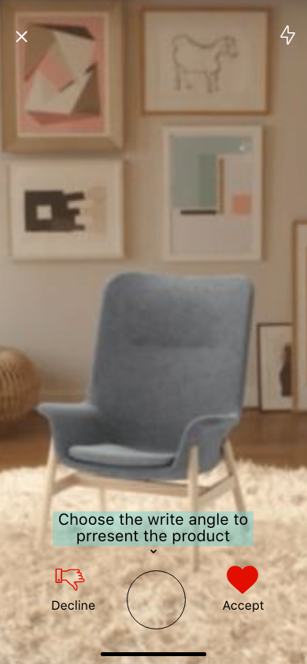
High-fidelity :
product page
Basket Page
Camera AR Page

Slide 26

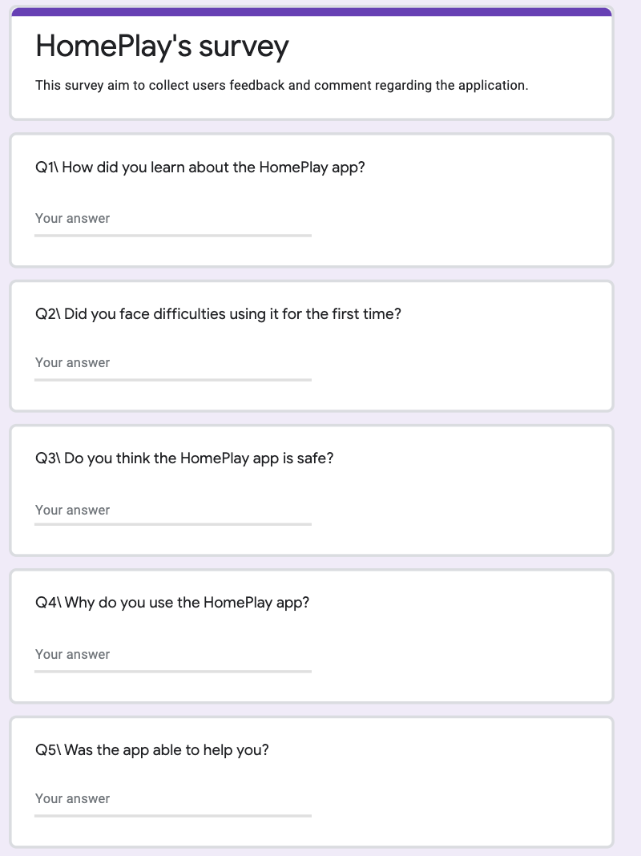
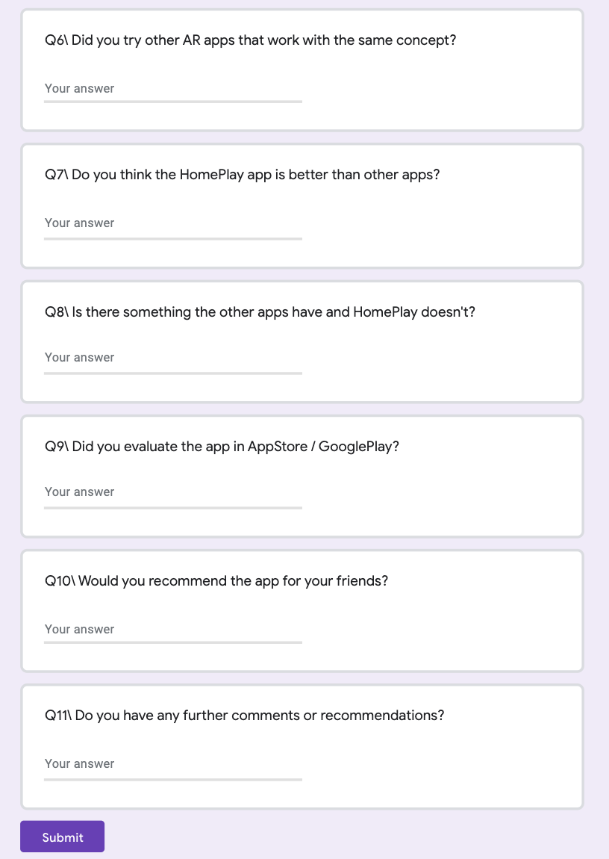
Task analysis through surveys

Slide 27

Evaluation:
# | Heuristic | Abbreviation | Notes
1 | Visibility of system status | Visibility | The app will keep users informed about the latest furniture and will take the feedback from them after each delivery.
2 | Match between system and the real world | Match | The app will provide terms and phrases like the one used in users' day-to-day environment.
3 | User control and freedom | Control | The app will provide Undo and Redo facilities If the user didn’t like the furniture or wanted to look for another one, and they can exit the app any time.
4 | Consistency and standards | Consistency | The app is so simple and easy to use for at least 80% of new users, there won’t be any vague actions or explanations.
5 | Help users recognize, diagnose and recover from errors | Recovery | The app will show clear error messages that precisely indicate the problem and constructively suggest a solution. Plain language will be used (no codes).
6 | Error prevention | Error | The app was designed carefully to prevent a problem from occurring in the first place.
7 | Recognition rather than recall | Recognition | A list of all selected furniture by the user will be shown so the user can compare the objects in a better and clearer way.
8 | Aesthetic and minimalist design | Aesthetics | The app will focus on showing the necessary information about the objects, irrelevant or rarely used information won’t be shown.
9 | Help and documentation | Help | The app will provide a searching bar that users can use to search for a specific object or specific furniture company.
10 | Flexibility and efficiency of use | Flexibility | The app is able to differentiate between the novice and expert users, and will provide shortcuts or guidelines to help them.

Slide 28


Future work:
Currently the app is in English, some other languages can be considered for future updates, for example: Turkish, Arabic, German, French.
One of our main future goals is to increase the number of suppliers (the companies that provide the furniture) in the application and thus the number of available furniture will increase, this will help to gain more users.
We will enhance the searching in the app and filtering methods, as we are planning to increase the number of objects then we will need a better filtering technique. The users will be able to sort products by price, style, colour or brand.
further work will be conducted in the texturing part, HomePlay app is able to change the colors of objects but will work to change its styles as well.
A nice addition to the project is to allow users to add lighting effects and shadows for the objects, to see the object in all its possible views.
Adding a sound effect is a future goal as well, it could be strange but some users will love to hear sounds of partıcular objects, for example the hammock.

Slide 29
TEAM#4
Thank You
The end

